Slide 1
McCulloch-Pitts Neuron

Slide 2
Theory
The McCulloch-Pitts neuron was the earliest neural network discovered in 1943.
It is usually called as M-P neuron. The M-P neurons are connected by directed weighted paths.
It should be noted that the activation of a M-P neuron is binary, that is, at any time step the neuron may fire or may not fire.
The weights associated with the communication links may be excitatory (weight is positive) or inhibitory (weight is negative).

Slide 3
Theory
All the excitatory connected weights entering into a particular neuron will have same weights.
There is a fixed threshold for each neuron, and if the net input to the neuron is greater than the threshold then then the neuron fires.
Any nonzero inhibitory input would prevent the neuron from firing.
The M-P neurons are most widely used in the case of logic functions.

Slide 4
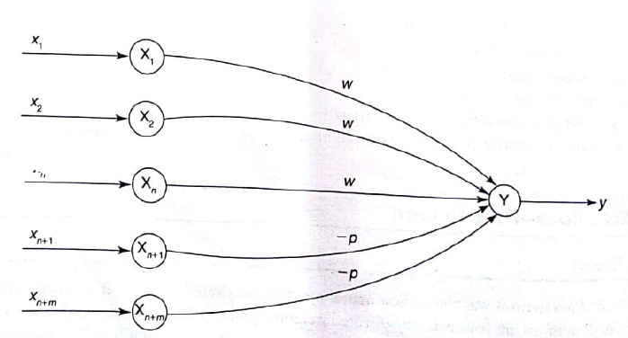

M-P NN Model Architecture
Has both excitatory with weight (w>0) and inhibitory with weight –p (p<0) connections.
Since the firing of the output neuron is based upon the threshold, the activation function is defined as

Slide 5

For inhabitation to be absolute, the threshold with the activation function should satisfy the following conditions:
Where n is the number of neuron with positive weight.
M-P neuron has no particular training algorithm.
The analysis has to be performed to determine the values of the weights and the threshold.
M-P neuron are used as building blocks on which we can model any function or phenomenon, which can be represented as a logic function.

Slide 6
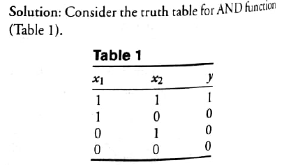
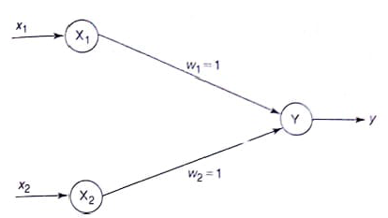
Question: Implement AND function using McCulloch-Pitts neuron (take binary data).
In M-P neuron, only analysis is being performed. Hence, assume the weights be w1=1 and w2=1.

Slide 7
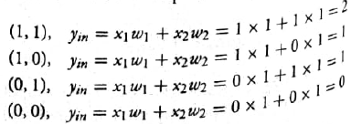
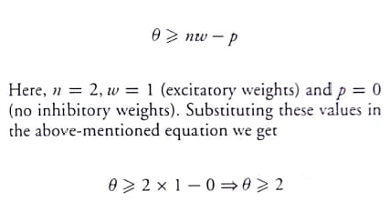
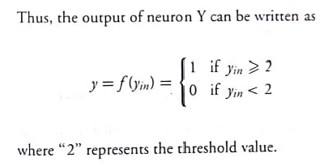
With assumed weights, the net input is calculated for four inputs:
For an AND function, the output is high if both the inputs are high.
For this condition, the net input is calculated as 2.
So threshold is set as 2.
If the threshold value >= 2 then the neuron fires, else it doesn’t fire.

Slide 8

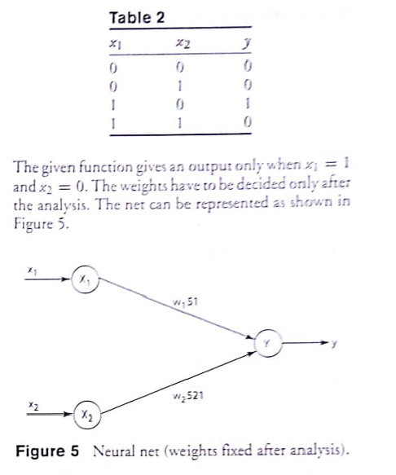
Question:
In ANDNOT function, response is true if first input is true and second false. For all other variations, response is false.

Slide 9
